Slide 1
Lecture 2

Slide 2
Plan of the lecture
Booleans
Operators
Lists
Tuples
Sets
Dictionaries

Slide 3
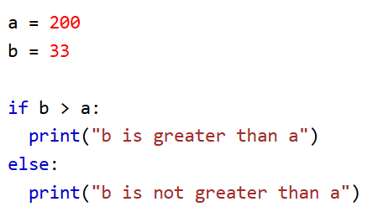
Booleans
In programming you often need to know if an expression is True or False.
You can evaluate any expression in Python, and get one of two answers, True or False.
When you compare two values, the expression is evaluated and Python returns the Boolean answer

Slide 4
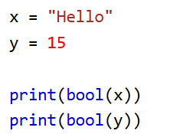
Booleans
The bool() function allows you to evaluate any value, and give you True or False in return
Most of those would return true
There are not many values that evaluate to False, except empty values, such as (), [], {}, "", the number 0, and the value None

Slide 5
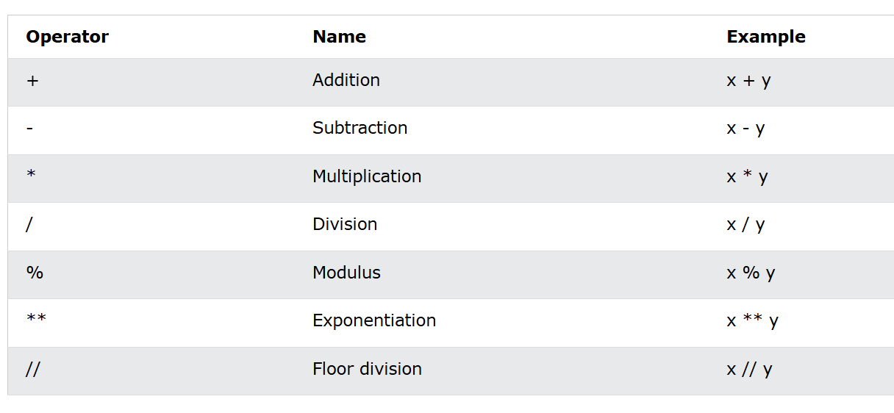
Operators
Python divides the operators in the following groups:
Arithmetic operators
Assignment operators
Comparison operators
Logical operators
Identity operators
Membership operators
Bitwise operators

Slide 6
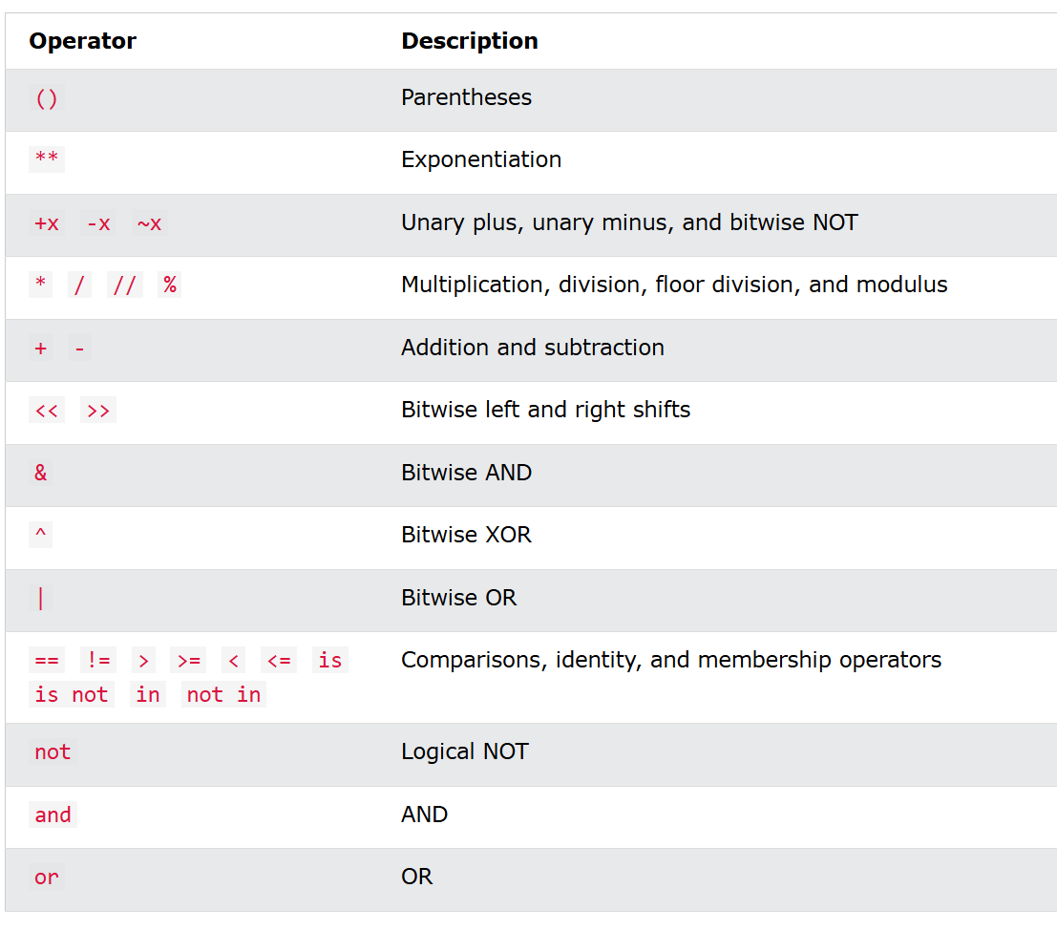
Operators
The precedence of the operators in python is defined to the right

Slide 7

List
Lists are used to store multiple items in a single variable.
Lists are created using square brackets
Lists are mutable data type

Slide 8


List
To determine how many items a list has, use the len() function
A list can contain different data types

Slide 9


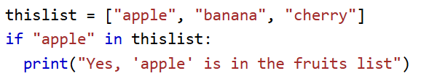
List
List items are indexed and you can access them by referring to the index number
To determine if a specified item is present in a list use the in keyword

Slide 10
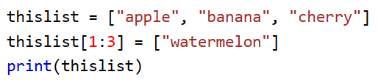
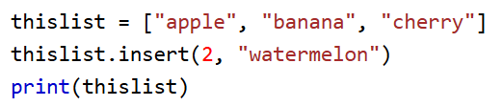
List
To change the value of items within a specific range, define a list with the new values, and refer to the range of index numbers where you want to insert the new values
To insert a new list item, without replacing any of the existing values, we can use the insert() method.

Slide 11
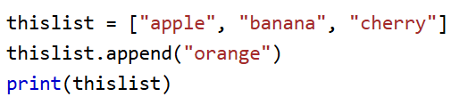
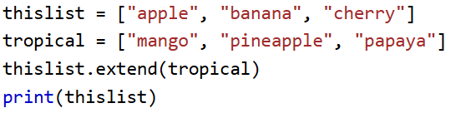
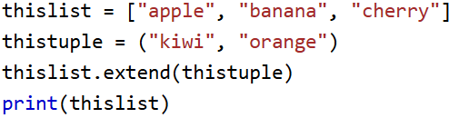
List
To add an item to the end of the list, use the append() method
To append elements from another list to the current list, use the extend() method
The extend() method does not have to append lists, you can add any iterable object (tuples, sets, dictionaries etc.).

Slide 12
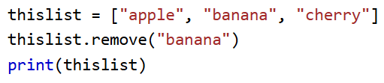
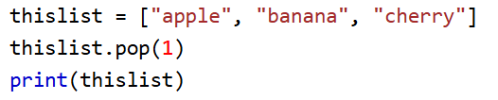
List
The remove() method removes the specified item.
If there are more than one item with the specified value, the remove() method removes the first occurrence.
The pop() method removes the specified index.

Slide 13
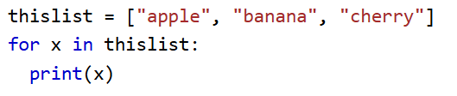
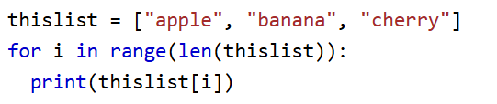
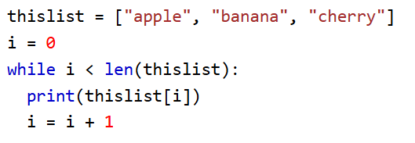
List
You can loop through the list items by using a for loop
You can also loop through the list items by referring to their index number.
Use the range() and len() functions to create a suitable iterable.
You can loop through the list items by using a while loop.

Slide 14
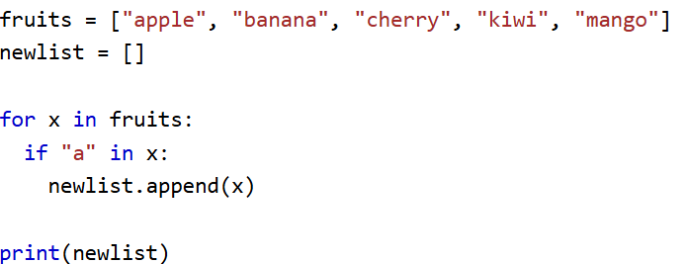
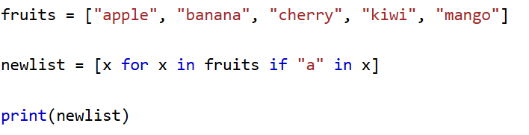
List comprehension
List comprehension offers a shorter syntax when you want to create a new list based on the values of an existing list.

Slide 15

Tuple
Tuples are used to store multiple items in a single variable.
Tuple is one of 4 built-in data types in Python used to store collections of data, the other 3 are List, Set, and Dictionary, all with different qualities and usage.
A tuple is a collection which is ordered and unchangeable.
Tuples are written with round brackets.

Slide 16
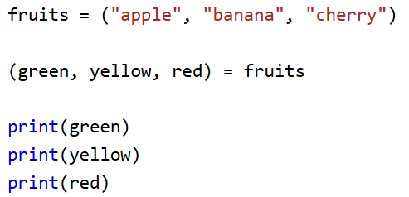
Tuple
When we create a tuple, we normally assign values to it. This is called "packing" a tuple
But, in Python, we are also allowed to extract the values back into variables. This is called "unpacking"

Slide 17

Set
Sets are used to store multiple items in a single variable.
Set is one of 4 built-in data types in Python used to store collections of data, the other 3 are List, Tuple, and Dictionary, all with different qualities and usage.
A set is a collection which is unordered, unchangeable*, and unindexed.
Sets cannot have two items with the same value.

Slide 18
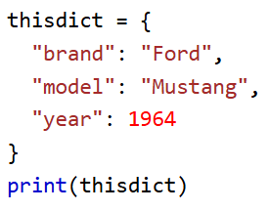
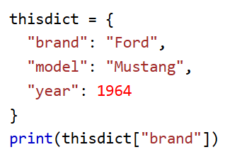
Dictionary
Dictionaries are used to store data values in key:value pairs.
A dictionary is a collection which is ordered*, changeable and do not allow duplicates.
As of Python version 3.7, dictionaries are ordered. In Python 3.6 and earlier, dictionaries are unordered.
Dictionaries are written with curly brackets, and have keys and values:

Slide 19
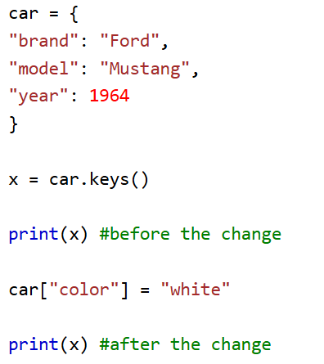
Dictionary
You can access the items of a dictionary by referring to its key name, inside square brackets
The keys() method will return a list of all the keys in the dictionary.

Slide 20
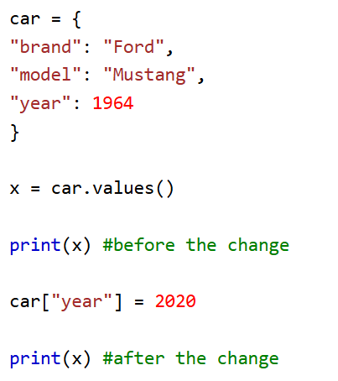
Dictionary
The values() method will return a list of all the values in the dictionary.
The list of the values is a view of the dictionary, meaning that any changes done to the dictionary will be reflected in the values list

Slide 21
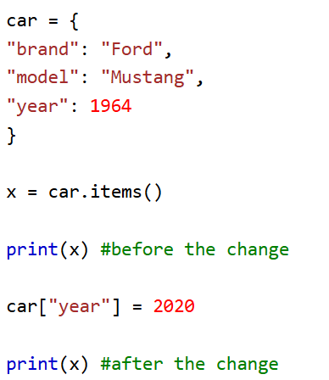
Dictionary
The items() method will return each item in a dictionary, as tuples in a list

Slide 22
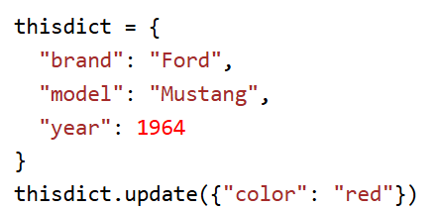
Dictionary
The update() method will update the dictionary with the items from a given argument. If the item does not exist, the item will be added.
The argument must be a dictionary, or an iterable object with key:value pairs.

